Slide 1
SSNAP data collection during Covid-19
1- What does the minimum dataset cover?
2- How to register/access
3- Key things to note
4- Why continuing to collect data
5- Q&A

Slide 2
WHAT DOES THE MINIMUM DATASET COVER?

Slide 3
WHAT DOES THE MINIMUM DATASET COVER?
I. Section 1 covers patient information. 13 items.
Inclusion criteria: all acute strokes coded as I61, I63 or I64. Aged 16 and over.

Slide 4
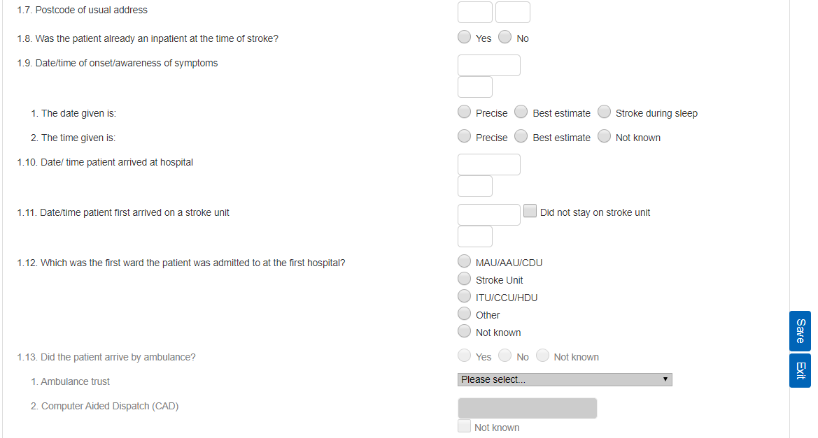

Slide 5
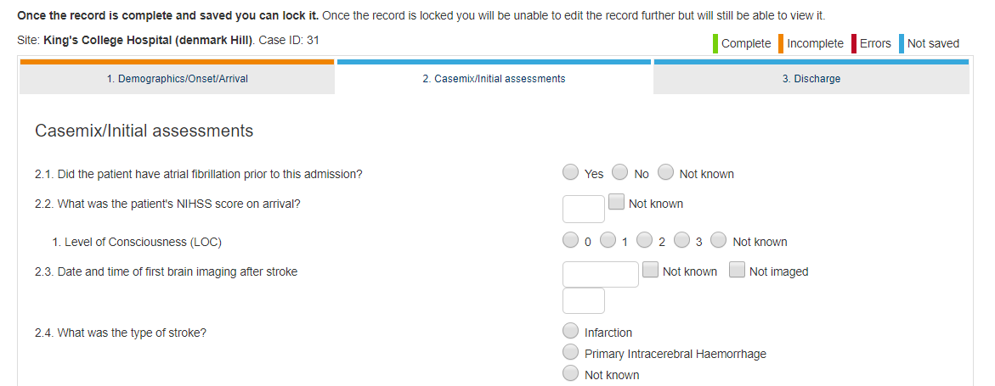
WHAT DOES THE MINIMUM DATASET COVER?
II. Section 2 covers key assessments and interventions. Only 2.12 (a & b) cover 72hs. 12 items.

Slide 6
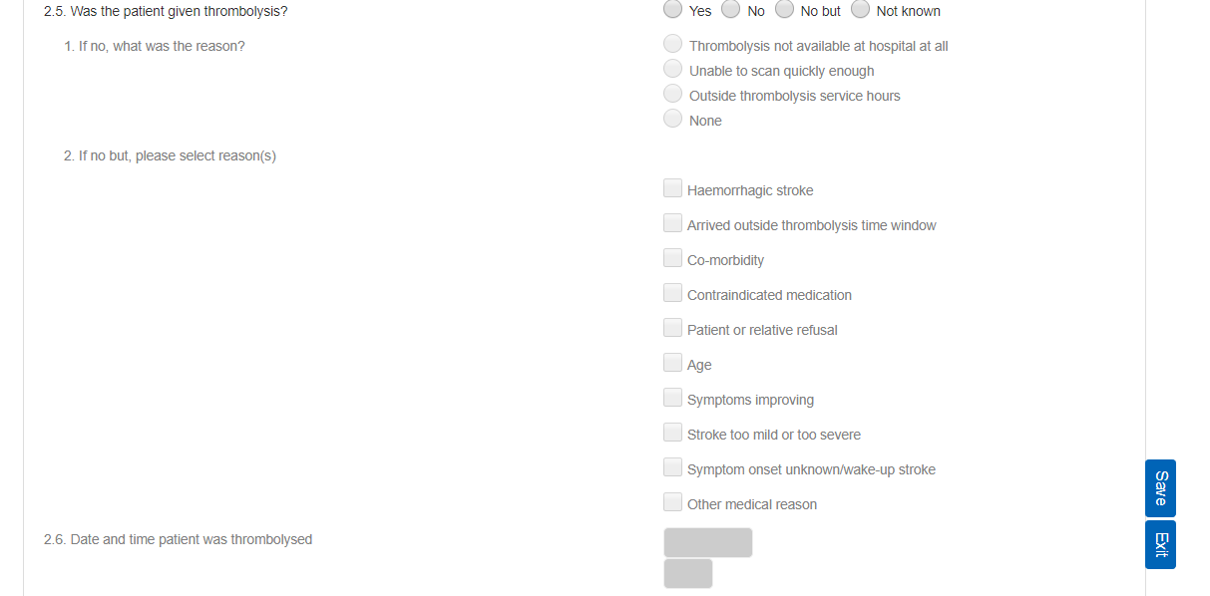

Slide 7
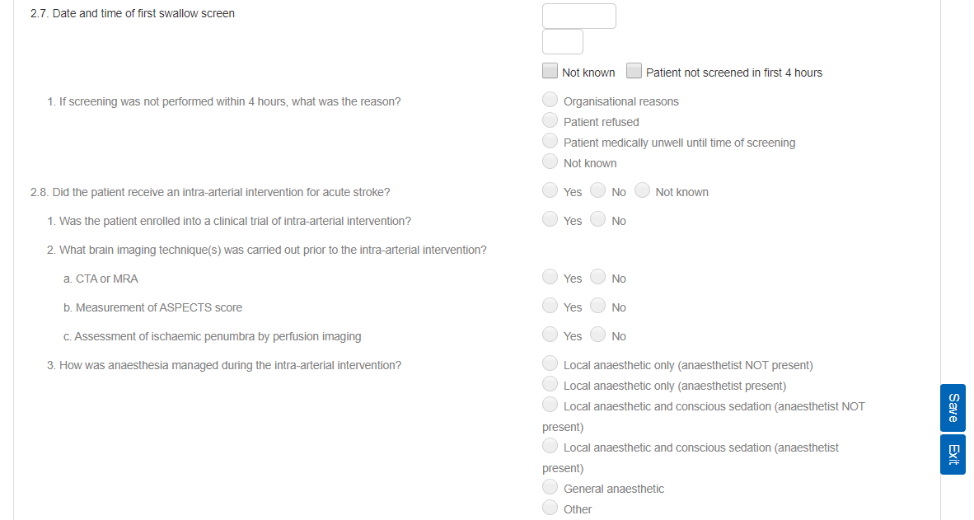

Slide 9
WHAT DOES THE MINIMUM DATASET COVER?
III. Section 3 covers the discharge process. 5 items.
2 Covid questions, also included in section 9 for teams completing the full dataset. All sections must be completed.

Slide 11
REGISTRATION & ACCESS
Leads and second leads of Routinely Admitting Teams.
No need to adhere the new team to the current SSNAP configuration.

Slide 12
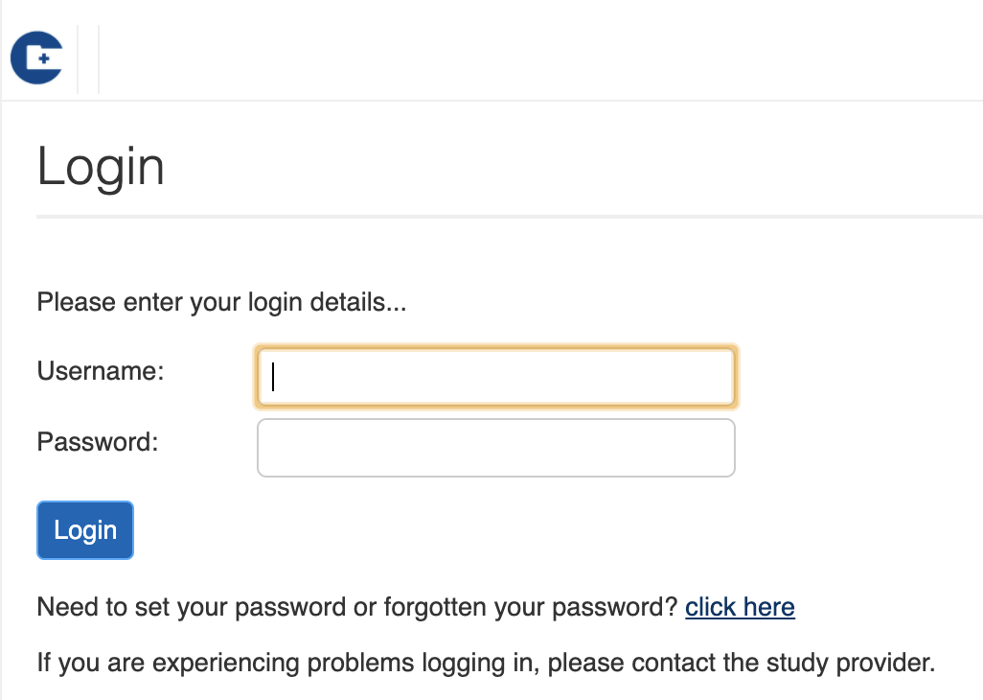
REGISTRATION & ACCESS

Slide 13
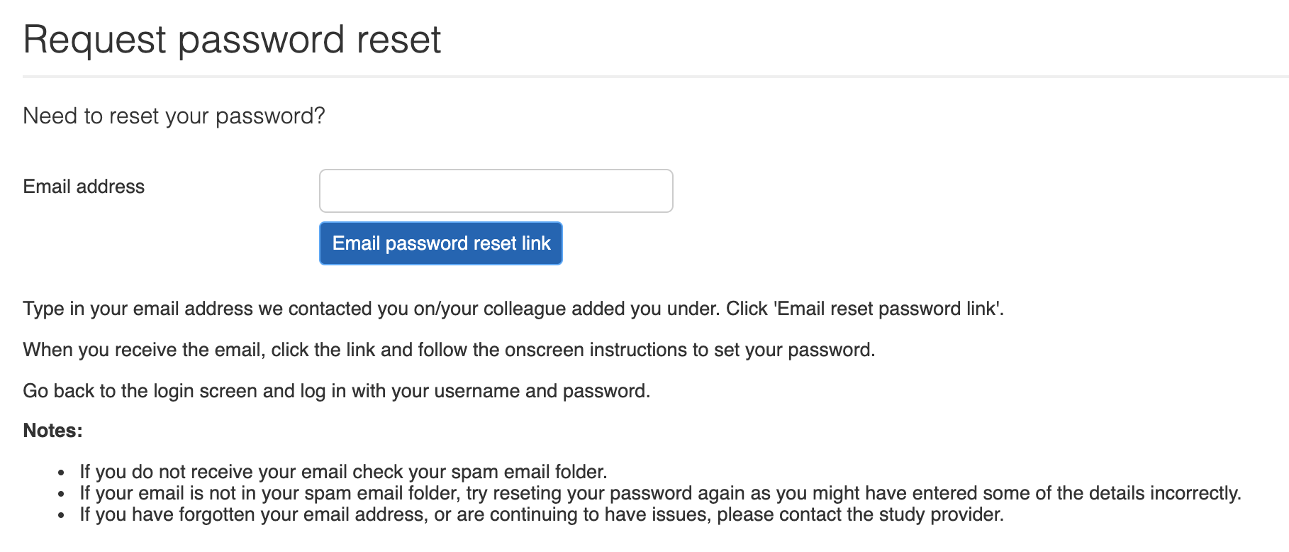
REGISTRATION & ACCESS

Slide 14
KEY THINGS TO NOTE
Records cannot be transferred to second teams.
Full completion in order to lock.
More “not known” options enabling teams to enter only the amount of data they are able to.
Normal dataset available for teams who wish to enter full data.

Slide 15
WHY CONTINUE TO COLLECT DATA?
Vital that we understand the impact of COVID-19 pandemic on stroke care
It appears that the number of admissions has reduced. Why?
Is it only severe stroke patients being admitted?
Has specialist stroke care been sacrificed to deal with the COVID patients?
If so what impact has that had on stroke processes of care and outcomes?
What lessons can we learn from the present crisis to help develop robust stroke services for the future?

Slide 16
HOW WILL THE DATA BE USED?
Reporting will depend on the quantity and quality of data submitted
Internally within NHSE/I to help manage health care during the crisis. Will work with NHS Digital and the SUS team to combine SSNAP data with routine data to get the best idea of current services
Monthly spreadsheets aback to trusts submitting data if more than 10 cases over the month
Quarterly reports (depending on amount of data we have) just on the items in minimum data set whether submitted through the full dataset website or the short version. We will hope to be able to use the full data in due course for those continuing to use it
No scoring and probably no trust level public reporting during the crisis

Slide 17
QUESTIONS AND ANSWERS
Please remember to keep yourself muted during the Q&A session.
If you would like to ask any questions, please use the chat function (you can find it at the bottom of your screen).

Slide 18
Thank you for attending the SSNAP Covid dataset Webinar.
If you would like to send us any comment remember you can do it by email to ssnap@kcl.ac.uk
Remember you can find SSNAP Helpnotes and guidance going to https://ssnap.zendesk.com/
Follow us on Twitter ☺ @SSNAPaudit

