Slide 1
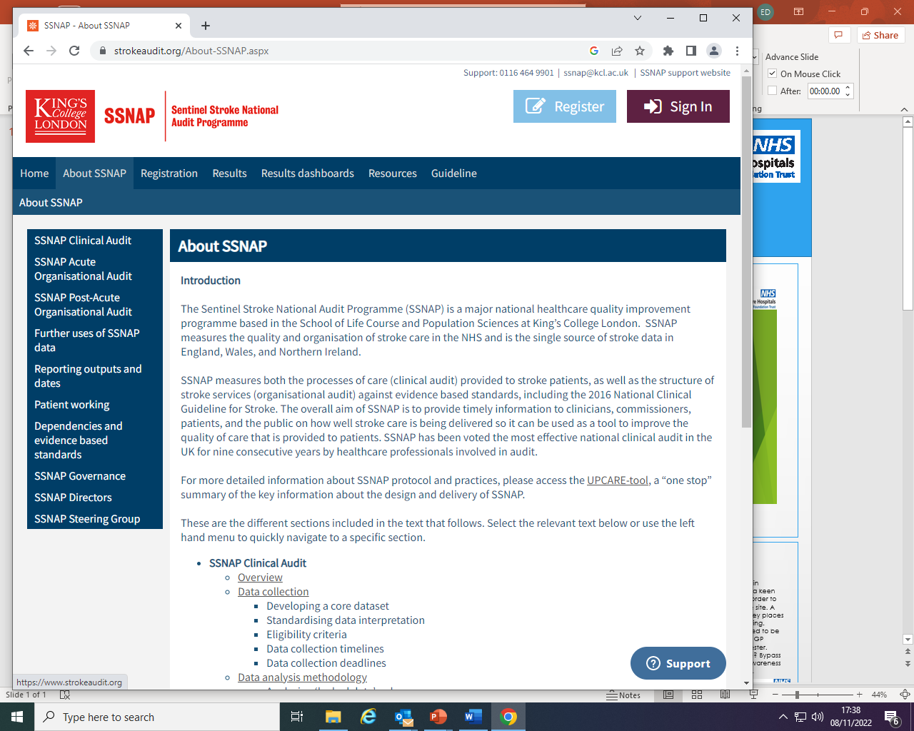
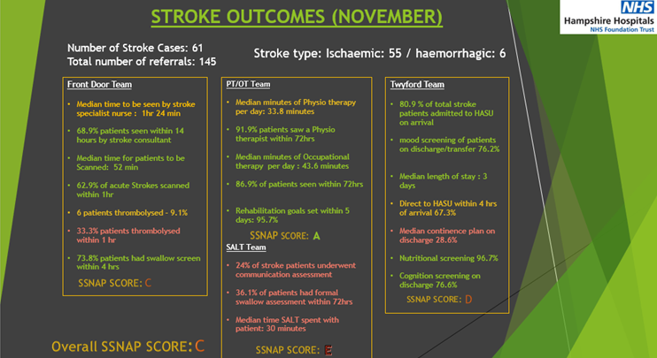
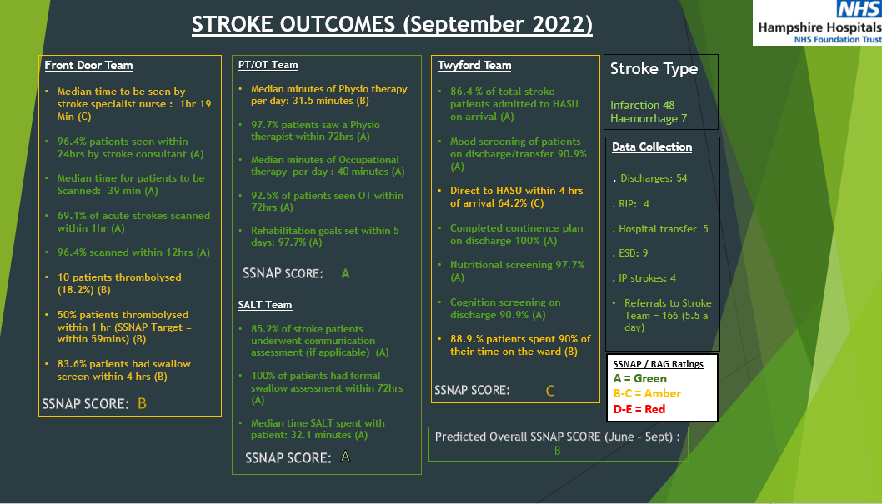
SSNAP Monthly data outcomes-
a marginal gains concept
SSNAP Crack Team: Daniel Emms, Chris Sanders, Zehra Mehdi, Steve Williams, Susan Wilson, Ela Tone, Mini Mathew, Julia Nasarwanji, Laura Dyer
Hampshire Hospitals NHS Foundation Trust
Background
Acute stroke is a medical emergency with 100,000 people (1 in 6) affected in the UK every year. Over the past 20 years mortality has reduced by 49% which is mainly attributed to better prevention, improved organisation of stroke units and pathways, development of specialist teams, and the introduction of earlier and more advanced treatments (Public Health England, 2018).
Along with the development of specialist teams, the need for a system to audit these stroke services arose in order to provide data analysis for the quality improvement of stroke services. Such a system is provided by the Sentinel Stroke National Audit Programme (SSNAP), developed by Kings College, London. SSNAP is a data analysis system providing quarterly reports measuring the quality and organisation of stroke care within the NHS across the United Kingdom. However, quarterly analysis does not facilitate real time improvements.
At Hampshire Hospitals NHS Foundation Trust (HHFT) the stroke service and the hyper acute treatment access is based at Royal Hampshire County Hospital (RHCH), and the stroke pathways have been developed to ensure that the best possible evidence based interventions are offered in a time critical manner.
In order to meet the standards set, a SSNAP ‘Crack Team’ was developed to implement a marginal gains approach to improve the service for patients. Marginal gains was developed by Sir David Brailsford in his role as performance director of British Cycling. It is the theory that small yet significant improvements can lead to monumental results. This approach allows a team to focus on constant measuring and monitoring of key statistics.
Fig 4. HHFT Trust initial stroke outcome data pull using RAG system – November 2021
Project Aim
To develop a MDT SSNAP Crack Team
To adopt a marginal gains approach to service improvement utilising SSNAP data by creating a monthly stroke data pull and stroke outcome scoring system.
Outcomes
The new reporting system has raised awareness amongst the MDT of HHFT SSNAP data and improved the following outcomes:
Improved thrombolysis times and rates
Improved CT scanning times
Significant improvement in SLT targets (red score in all domains -> all green!)
The SSNAP Crack team has improved MDT understanding of how SSNAP data is recorded and reported. It has also highlighted areas where further improvement is needed such as the door to HASU times.
Project Design/ Strategy
A monthly review looking at SSNAP data was commenced with the aim of an MDT approach to quality improvement. Using the DIY tool, raw data was extracted from the SSNAP data main frame and correlated in line with SSNAP targets, providing percentages that enabled the development of the HHFT RAG system (Red, Amber, and Green) as well as a graded system (figure 4).
The SSNAP team consists of a range of backgrounds including; doctors, nurse, physio, data co-ordinator.
The analysis from the monthly data pull enables the SSNAP crack team to constantly measure various key aspects of the stroke service. A review of critical standards by the SSNAP Crack Team allows for areas of practice to be looked at in greater detail and any identified themes can then be analysed and actioned as per the driver diagram (figure 2). We recognised that at this stage, it is important to take a step back, to stop looking for solutions and spend some time analysing the data.
Fig 1. Key indicators that needed improvement Fig 2. Driver Diagram
Meeting SSNAP critical time standards.
D2N <1 hour
SCAS
CT delays
Door to HASU< 4 hours
Pre-alert phone
Implement Direct to Ct pathway
Swallow Screen
Stroke Specialists
SSNAP data coordinator
Education
Nurse in Charge
Nurse in Charge Bleep introduced
ED
Education and engagement
Analysing reporting processes
Results (Nov 2021- Sept 2022.) Patients thrombolysed 72 hr communication assessment Formal swallow assessment Time SALT spent with SLAT Admitted to Twyford within 4 hours Continence planning
Lessons Learned
SSNAP MDT meetings with engagement of all stroke specialties, education and staff awareness is key.
Regular evaluation of key indicators and time critical standards maintains consistent positive change.
Education of ED team is vital and has commenced with engaged stroke link nurses.
Analysing data on a monthly basis using a colour coded system has helped the team to identify themes that can be acted upon promptly
Aim to ensure that changes are successful but more importantly sustained
Stop, evaluate. Can we progress slowly 1% at a time or put small things in place to contribute towards the overall SSNAP goal?
Ongoing data inputting and monthly analysis allows for continuous improvement in stroke services, we won’t always get it right but we aim to learn and improve together!
Notes:
? Consider bullet points? ? emails

